Slide 1
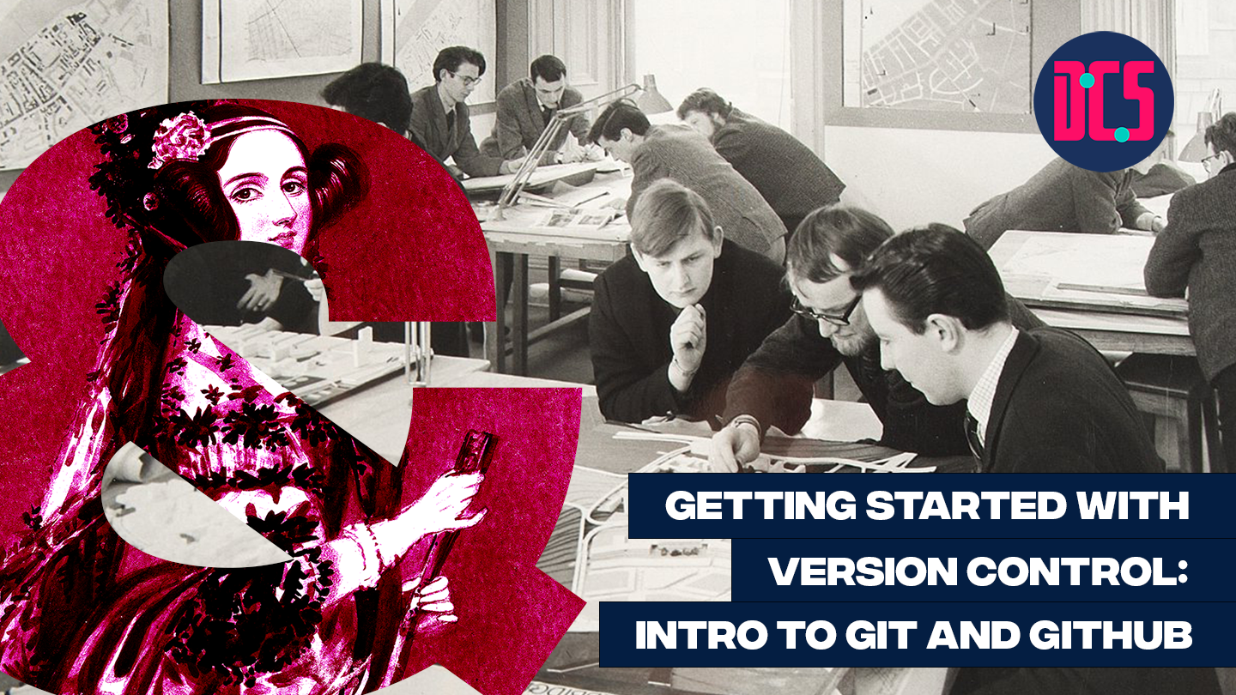

Slide 2

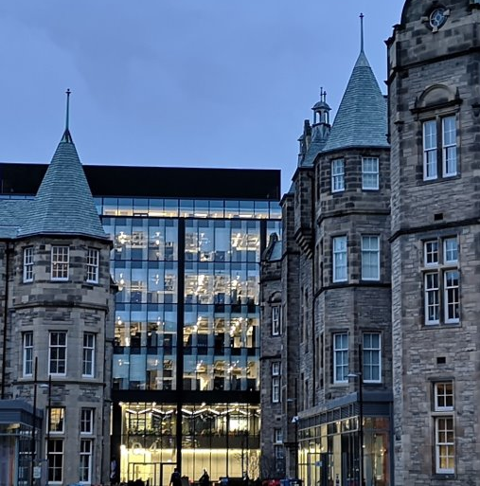

Support for data-led and applied digital research across the arts, humanities and social sciences.
Notes:
MT

Slide 3
Upcoming events & Training
16/11 Fika A chance to meet others working with digital resources and methods and talk tech over a cup of tea and a slice of cake
28/11 PhDs & ECR Social
29/11 Town Hall Meeting Autumn 2023
30/11 Masterclass on Keyphrase Network Analysis
01/12-08/12 Build your Personal or Project Website with GitHub Pages
13/12 Annual Lecture 23 Mary Flanagan “How to See What’s Missing”
Notes:
MT

Slide 4


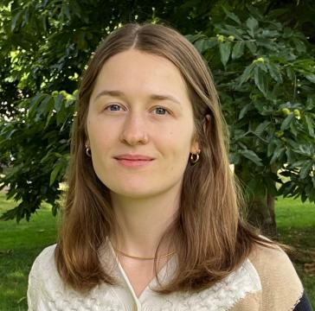
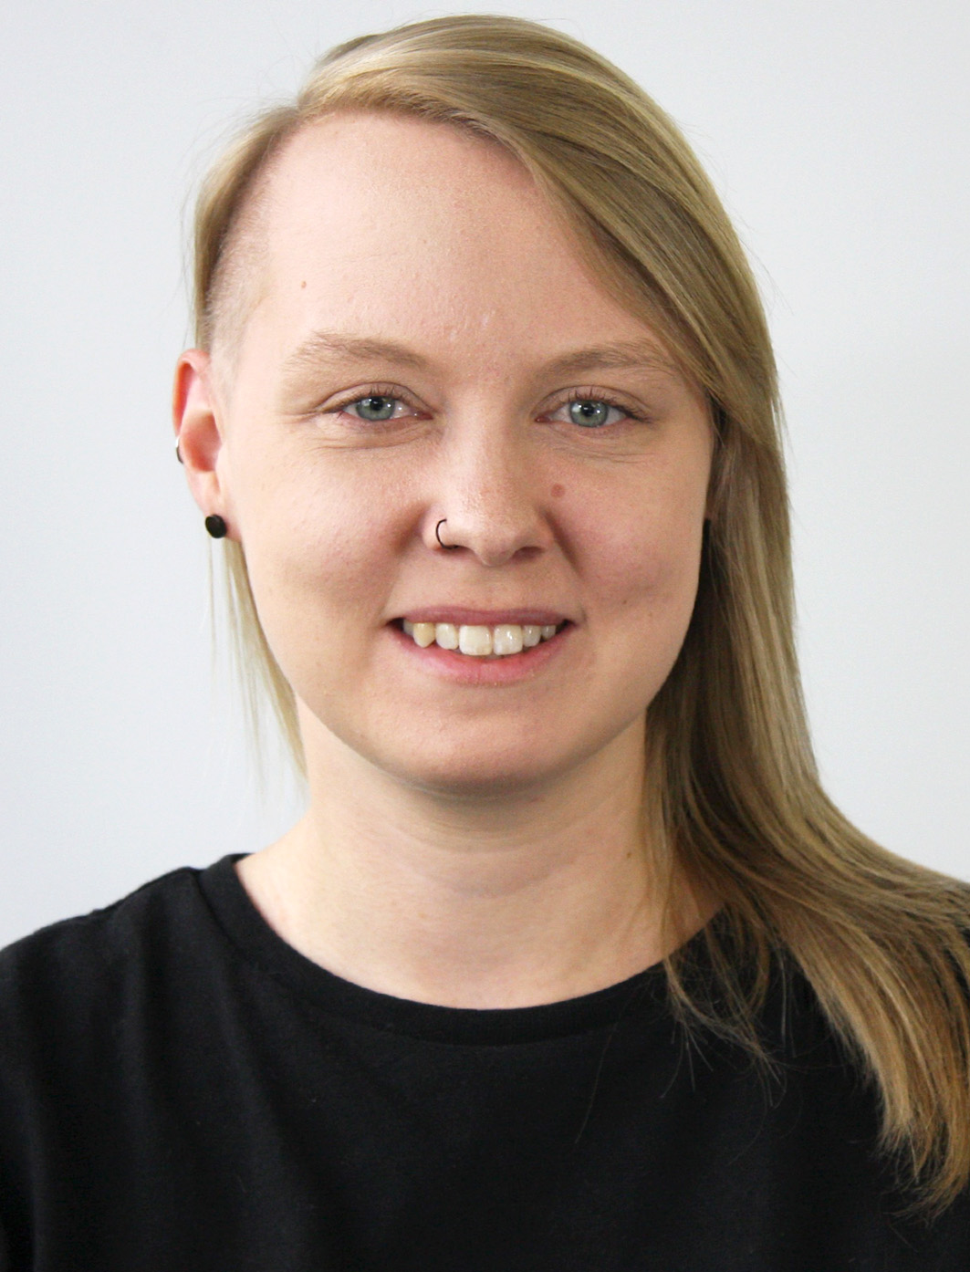
Welcome!
Sarah Schöttler
PhD student in data visualization & visualization developer
Aislinn Keogh
PhD student in Linguistics
www.cdcs.ed.ac.uk

Slide 5
Plan for Today
14:00 Welcome & Introduction
14:15 Live demo: Create your first repo & your first commit
Troubleshooting
15:00 Break
15:10 Live demo: Fork a repo & create a pull request
Troubleshooting
15:50 Wrap up & additional resources
www.cdcs.ed.ac.uk

Slide 6
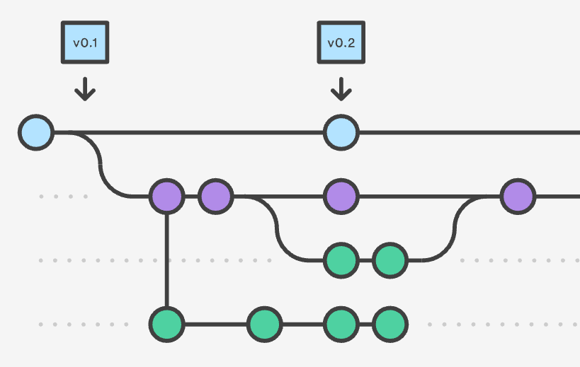
Version Control
Version control is the practice of tracking and managing changes to software code.
Version control software keeps track of every modification to the code in a special kind of database.
Version control helps tracking every individual change by each contributor and helping prevent concurrent work from conflicting.
It is a standard workflow in the tech industry.
www.cdcs.ed.ac.uk

Slide 7
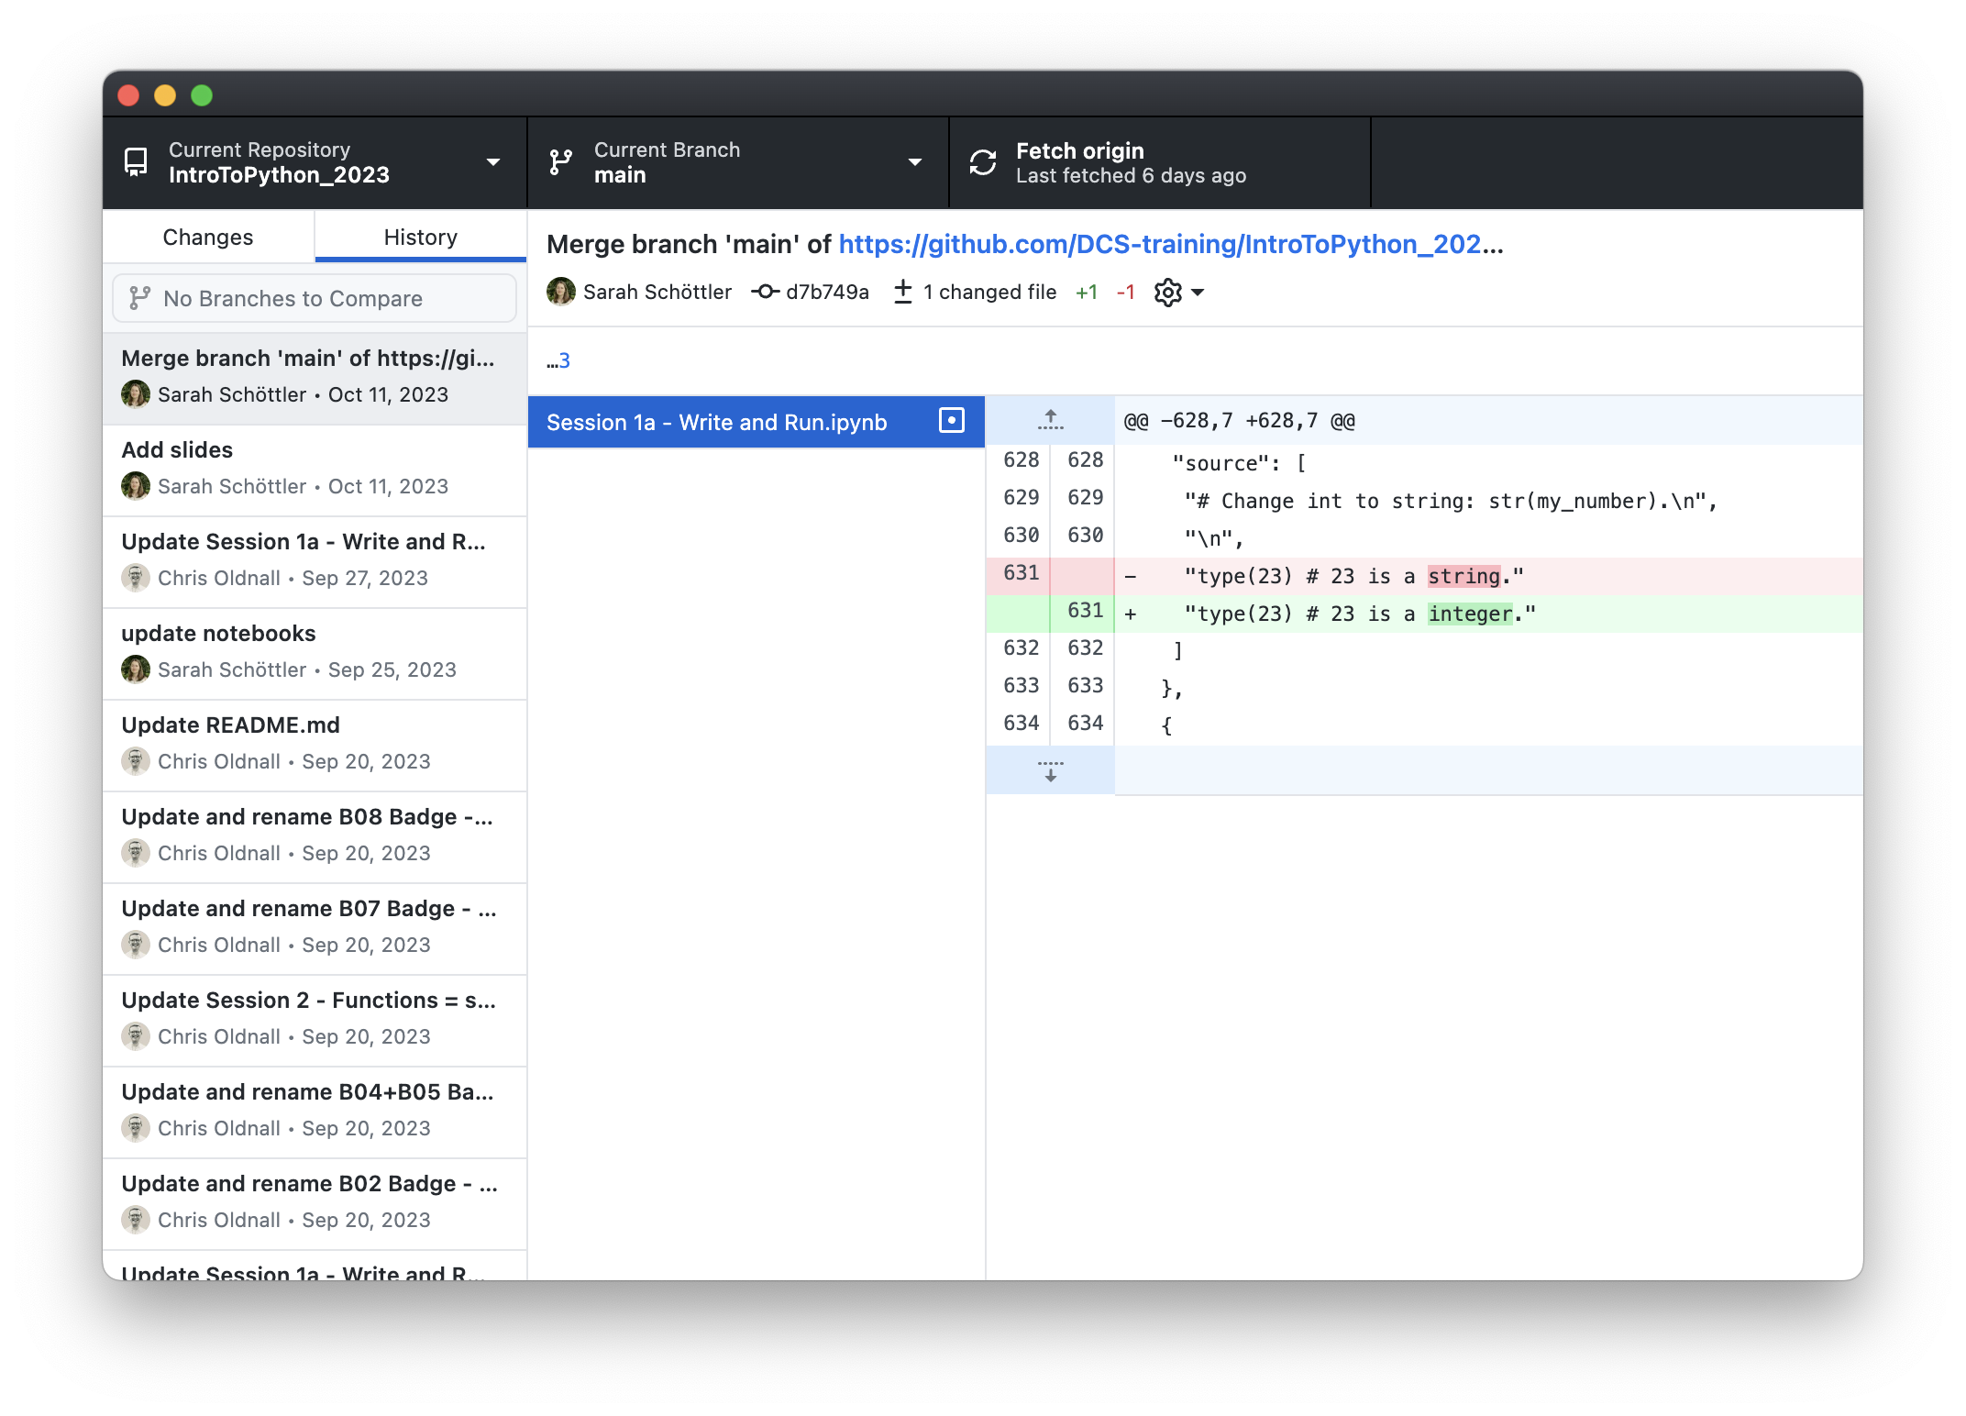
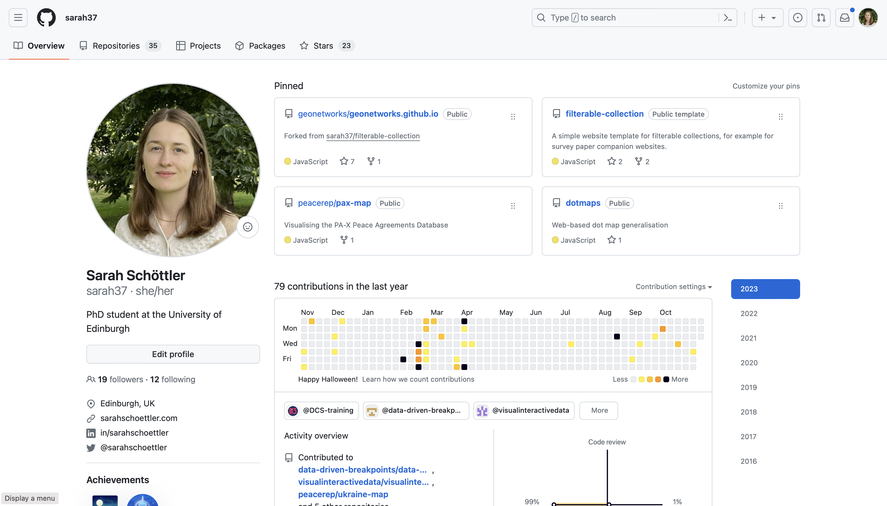
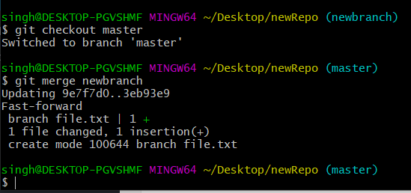
git | GitHub | GitHub Desktop
A distributed version control system | An online platform for collaborating on code, based on git | A desktop application for working with git and GitHub on your computer
No need to learn this for basic use cases!
Image from https://funkyvast.weebly.com/ what-is-git-bash-terminal.html
www.cdcs.ed.ac.uk

Slide 8
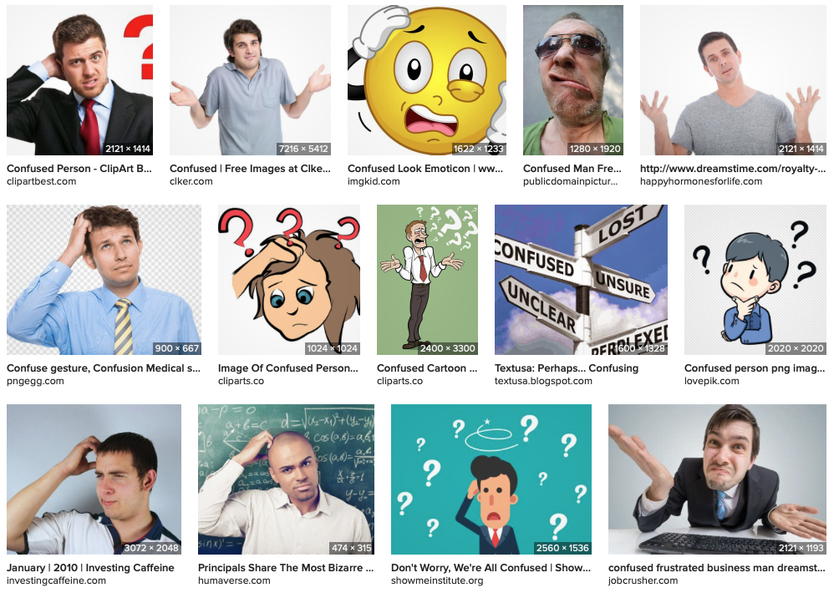
Terminology
repository/repo
commit
clone
branch
fetch
pull
push
fork
www.cdcs.ed.ac.uk

Slide 9
Terminology
repository/repo
commit
clone
branch
fetch
pull
push
fork
→ a “folder” for your code for one project
→ saving your changes in the project
→ a copy of a repo (e.g., on your computer)
www.cdcs.ed.ac.uk

Slide 10
Live Demo: Creating your first repo
Go to www.github.com
Sign in / sign up
Click the + in the top right corner and select “New repository”
Choose a repository name, check “Add a README file”, and leave all other fields.
Click “Create repository”
www.cdcs.ed.ac.uk

Slide 11
Live Demo: Cloning your repo with GitHub Desktop
Install GitHub Desktop from https://desktop.github.com if you haven’t yet
On the GitHub page for your repo, click “Open in GitHub Desktop”
Choose where to clone your repo
Click fetch & admire your repo in GitHub Desktop
www.cdcs.ed.ac.uk

Slide 12
Live Demo: Making a commit
Open the README file in a text editor of your choice If you’re unsure: on Windows use Notepad; on Mac use TextEdit
Make some changes in your README file and save them
In GitHub Desktop, describe your commit and click commit when ready
Push to GitHub
www.cdcs.ed.ac.uk

Slide 13
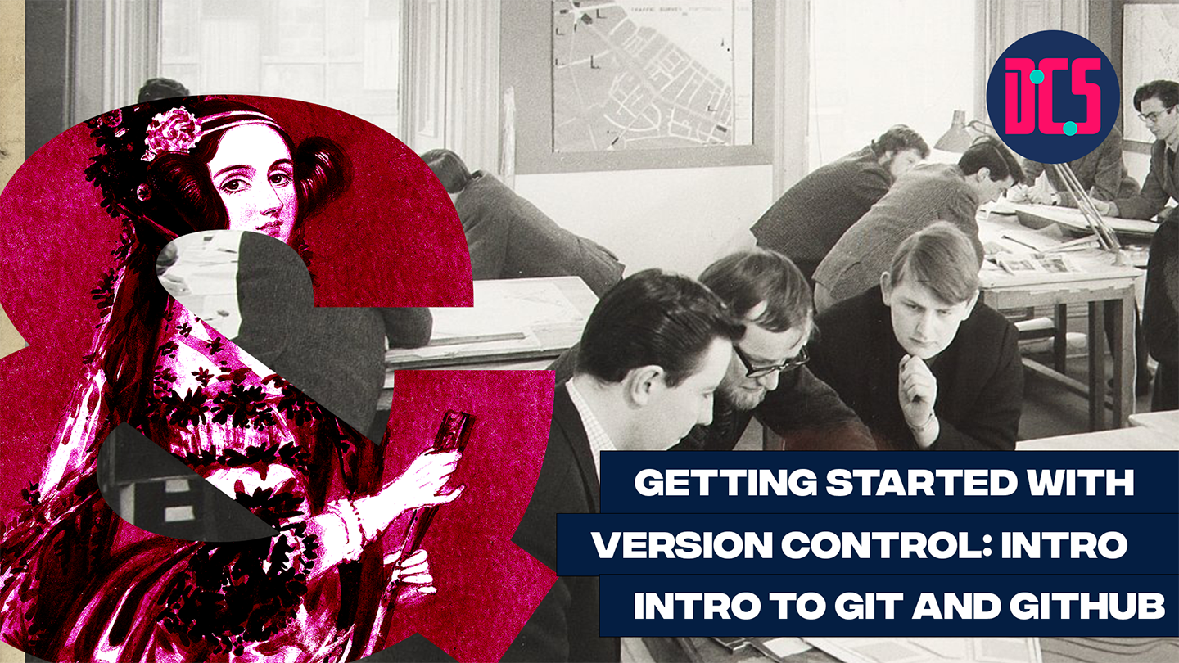
Break

Slide 14
Terminology
repository/repo
commit
clone
branch
fetch
pull
push
fork
→ a “folder” for your code for one project
→ saving your changes in the project
→ a copy of a repo (e.g., on your computer)
→ a parallel version of a repo (repos can have multiple branches)
→ getting the latest changes from the online repo
→ integrating the latest changes into your clone of the repo
→ sending your changes (your commits) to the server
→ a personal copy of someone else’s repo
www.cdcs.ed.ac.uk

Slide 15
Live Demo: Forking a repo, making a commit, and making a pull request
Find a partner and get the link to their GitHub repo. Fork it on GitHub, then add your fork to GitHub Desktop.
Make a change to their README, commit, and push.
On GitHub, view your fork and open a pull request.
Review and approve each other’s pull requests.
www.cdcs.ed.ac.uk

Slide 16
Additional Resources
GitHub online tutorials
Introduction (tutorial repeating some of what we did today): https://github.com/skills/introduction-to-github
Reviewing pull requests: https://github.com/skills/review-pull-requests
Resolving merge conflicts: https://github.com/skills/resolve-merge-conflicts
List of all skills tutorials: https://github.com/skills
GitHub student pack: https://education.github.com/pack
www.cdcs.ed.ac.uk

